Slide 1
General Purpose I/O
ENEE 3587
Microp Interfacing

Slide 2
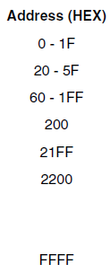
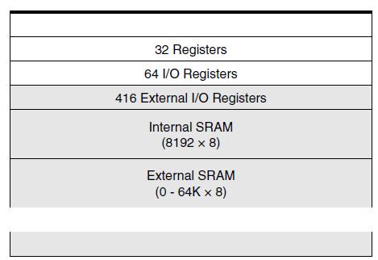
Memory Mapped IO Registers
IO pins, functions, control are mapped to IO registers in memory
Simply write to or read an IO register to
read signals from, produce signals on to pins,
set pin functions,
control pin operation,

Slide 3
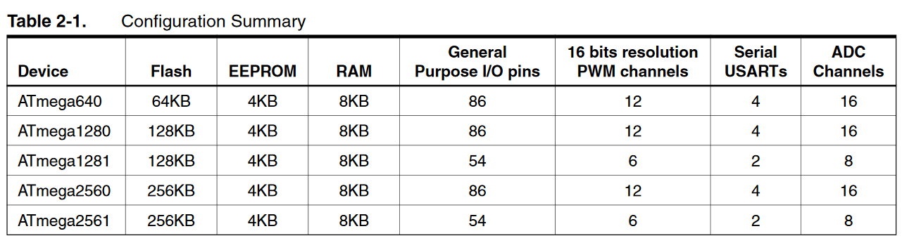
GPIO
Aka Ports
Used for input/output

Slide 4
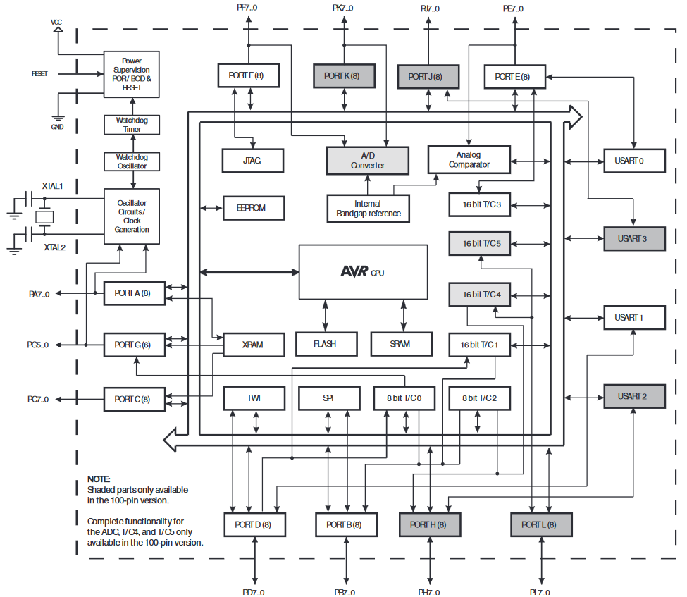

Slide 5
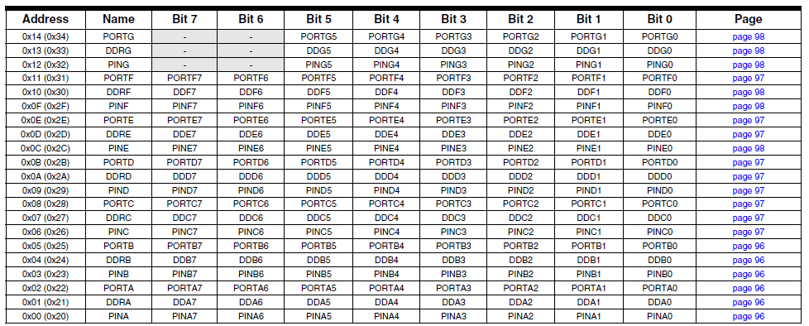
Sample from the datasheets pp 399-403

Slide 6
Ports
8-bit IO GPIO pins
Ports A, B, C, D, E, F, G, H, J, K, L
Each port has a byte register: PORTx
E.g. PORTA
Each port has direction register to control IO: DDRx
E.g. DDRA byte register controls input/output function on PORTA
Use ‘1’ for output direction, ‘0’ input
Each port has read register PINx:
E.g. PINA
Provides actual voltage levels on the pins (helps detect faults or read data)

Slide 7
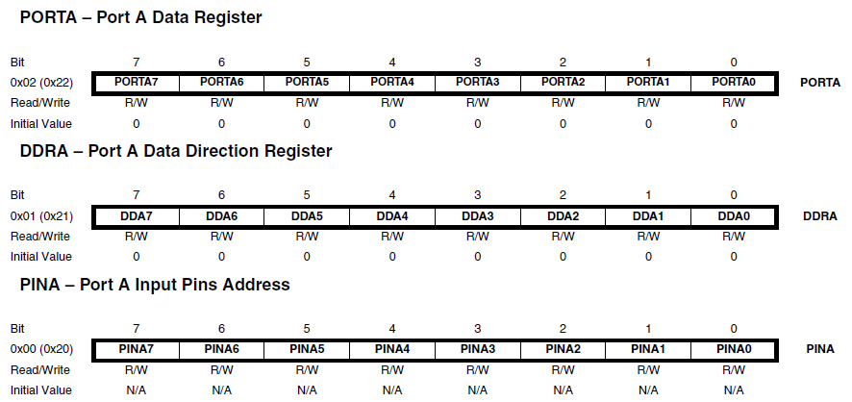

Slide 8
Configuring PORT
DDRxn: Direction register for PORT x, pin n
PORTxn: PORT x register, pin n
PUD = pull-up disable bit from register MUCR
DDRxn | PORTxn | PUD | I/O | Pull Up | Comment
0 | 0 | x | Input | No | Tri-state (Hi-Z)
0 | 1 | 1 | Input | No | Tri-state (Hi-Z)
0 | 1 | 0 | Input | Yes | PAn will source current if ext. pulled low.
1 | 0 | x | Output | No | Push-pull Zero Output
1 | 1 | x | Output | No | Push-pull One Output

Slide 9
Examples
DDRA = 0x00; // set PortA as input with internal pull-ups on
PORTA = 0xFF;
DDRA = 0x00; // set PortA as input with internal pull-ups off
PORTA = 0x00;
DDRA = 0xFF; // set PortA for output
PORTA = 0x00;
DDRA = 0x0F; // set PortA for both input and output
PORTA = 0xF0; // upper 4 => input, lower 4 => output
DDRA = 0xAA; // set PortA for both input and output
PORTA = 0x55; // pull-ups are on

Slide 10
PORTx vs PINx
PINxn enables access to the physical value on each Port x pin n.
Reading PORTx: Data Latch is read associated with PORT x is read
Reading PINx: the logical values present of the pins are read.
These should be the same:
If there is a difference between the PORTxn and PINxn then the input is faulty

Slide 11
PORT Alternate Functions
Each port also have alternate functions
See datasheets pp 75 - 95
You must decide whether you are using port pin for GPIO or alternate functions

